Slide 1

Sustainable Materials Management
Prof. Dr. Karl Vrancken
Research coordinator transition energy and environment
3Ba BIR - UA
Milieutechnologie

Slide 2

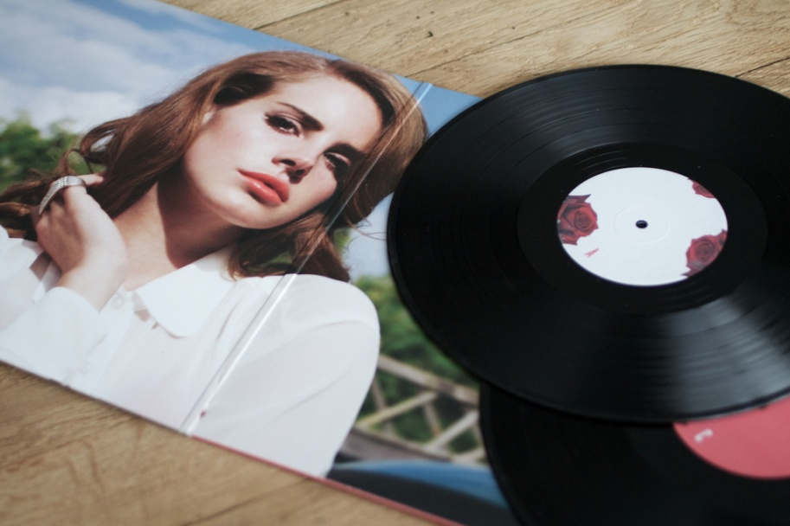

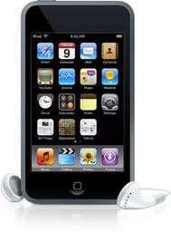
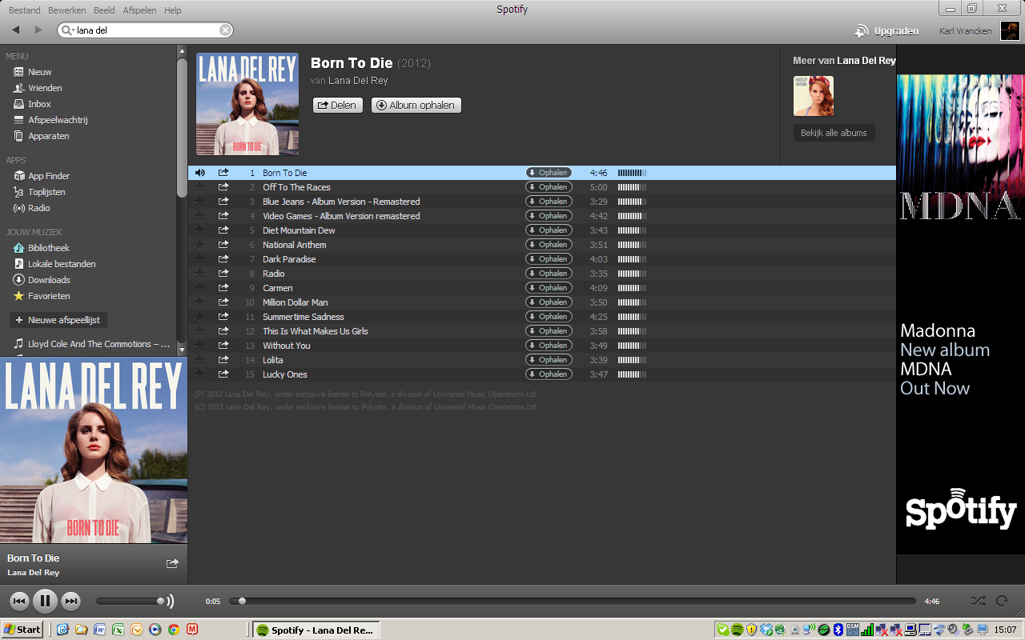
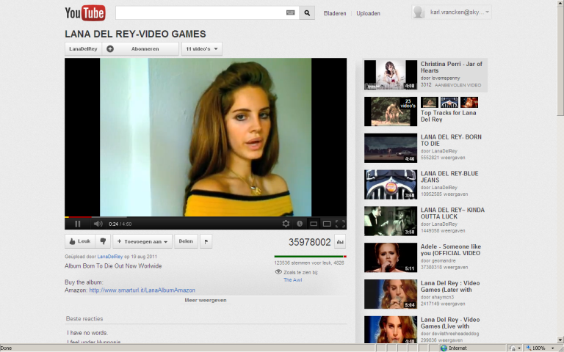

Slide 3
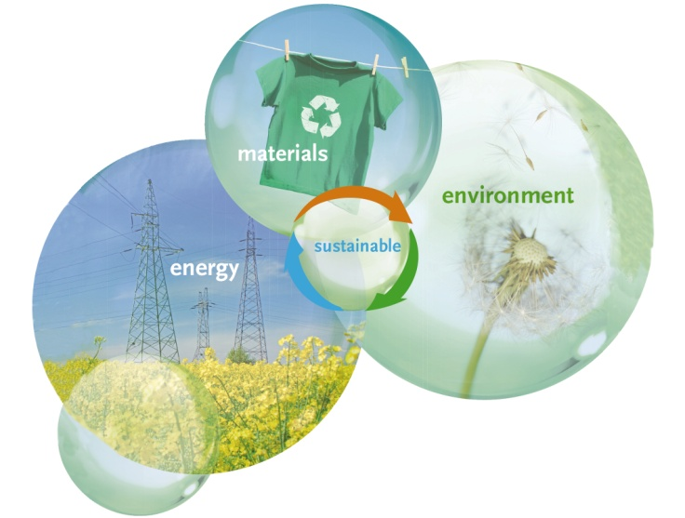
Today’s challenges
Socio-economic:
fast growing population
economic crisis, financial crisis
Environmental:
global warming, pollution
Availability of natural resources:
energy, water, raw materials
Geo-political situation:
access to energy, water and material resources
Health and safety:
working conditions
product safety, long term impacts

Slide 4
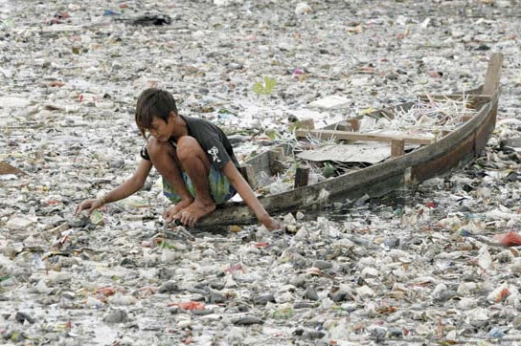
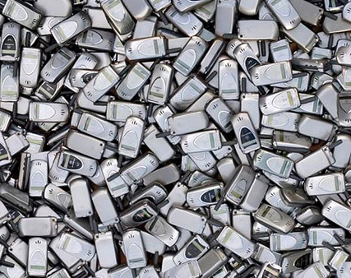
Sustainable use of Materials: why?
Societal Challenges
24mg Au/phone
EU >100 M mobile phones/year
2400 kg Au

Slide 5
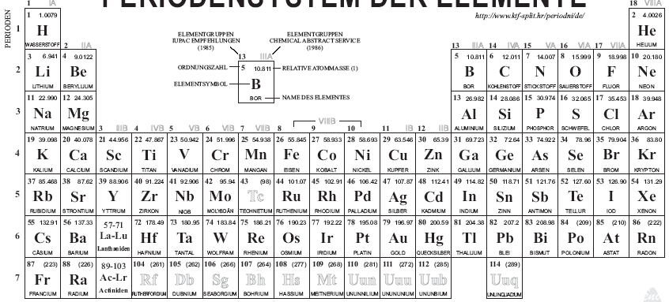
Material content of mobile phone
mobile phone substance (source Nokia)

Slide 6
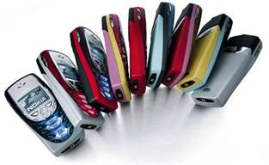

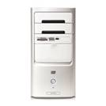
Impact on metals demand (from Umicore) 2 prominent examples
Global sales, 2006:
a) Cell phones:
1000 Million units
x 250 mg Ag ≈ 250 t Ag
x 24 mg Au ≈ 24 t Au
x 9 mg Pd ≈ 9 t Pd
x 9 g Cu ≈ 9000 t Cu
1000 M x 20 g/battery*
x 3.8 g Co ≈ 3800 t Co
* Li-Ion type
b) PC & laptops:
225 M units
x 1000 mg Ag ≈ 225 t Ag
x 220 mg Au ≈ 50 t Au
x 80 mg Pd ≈ 18 t Pd
x ≈ 500 g Cu ≈ 113,000 t Cu
≈ 75 M laptop batteries*
x 65 g Co ≈ 4900 t Co
** Li-Ion type is > 90% used in modern laptops
World Mine / a+b Production / share
Ag: 20,000 t/a ► 2.5%
Au: 2,500 t/a ► 3%
Pd: 230 t/a ► 12%
Cu: 16 Mt/a ► 1%
Co: 58,000 t/a ► 15%
Although “negligible” metal quantities per piece, the leverage of huge unit sales leads to significant total numbers !
value of these five metals at 2006 prices: 2.8 billion US-$
CO₂ burden for producing these metals (primary): 2.1 million t CO₂

Slide 7
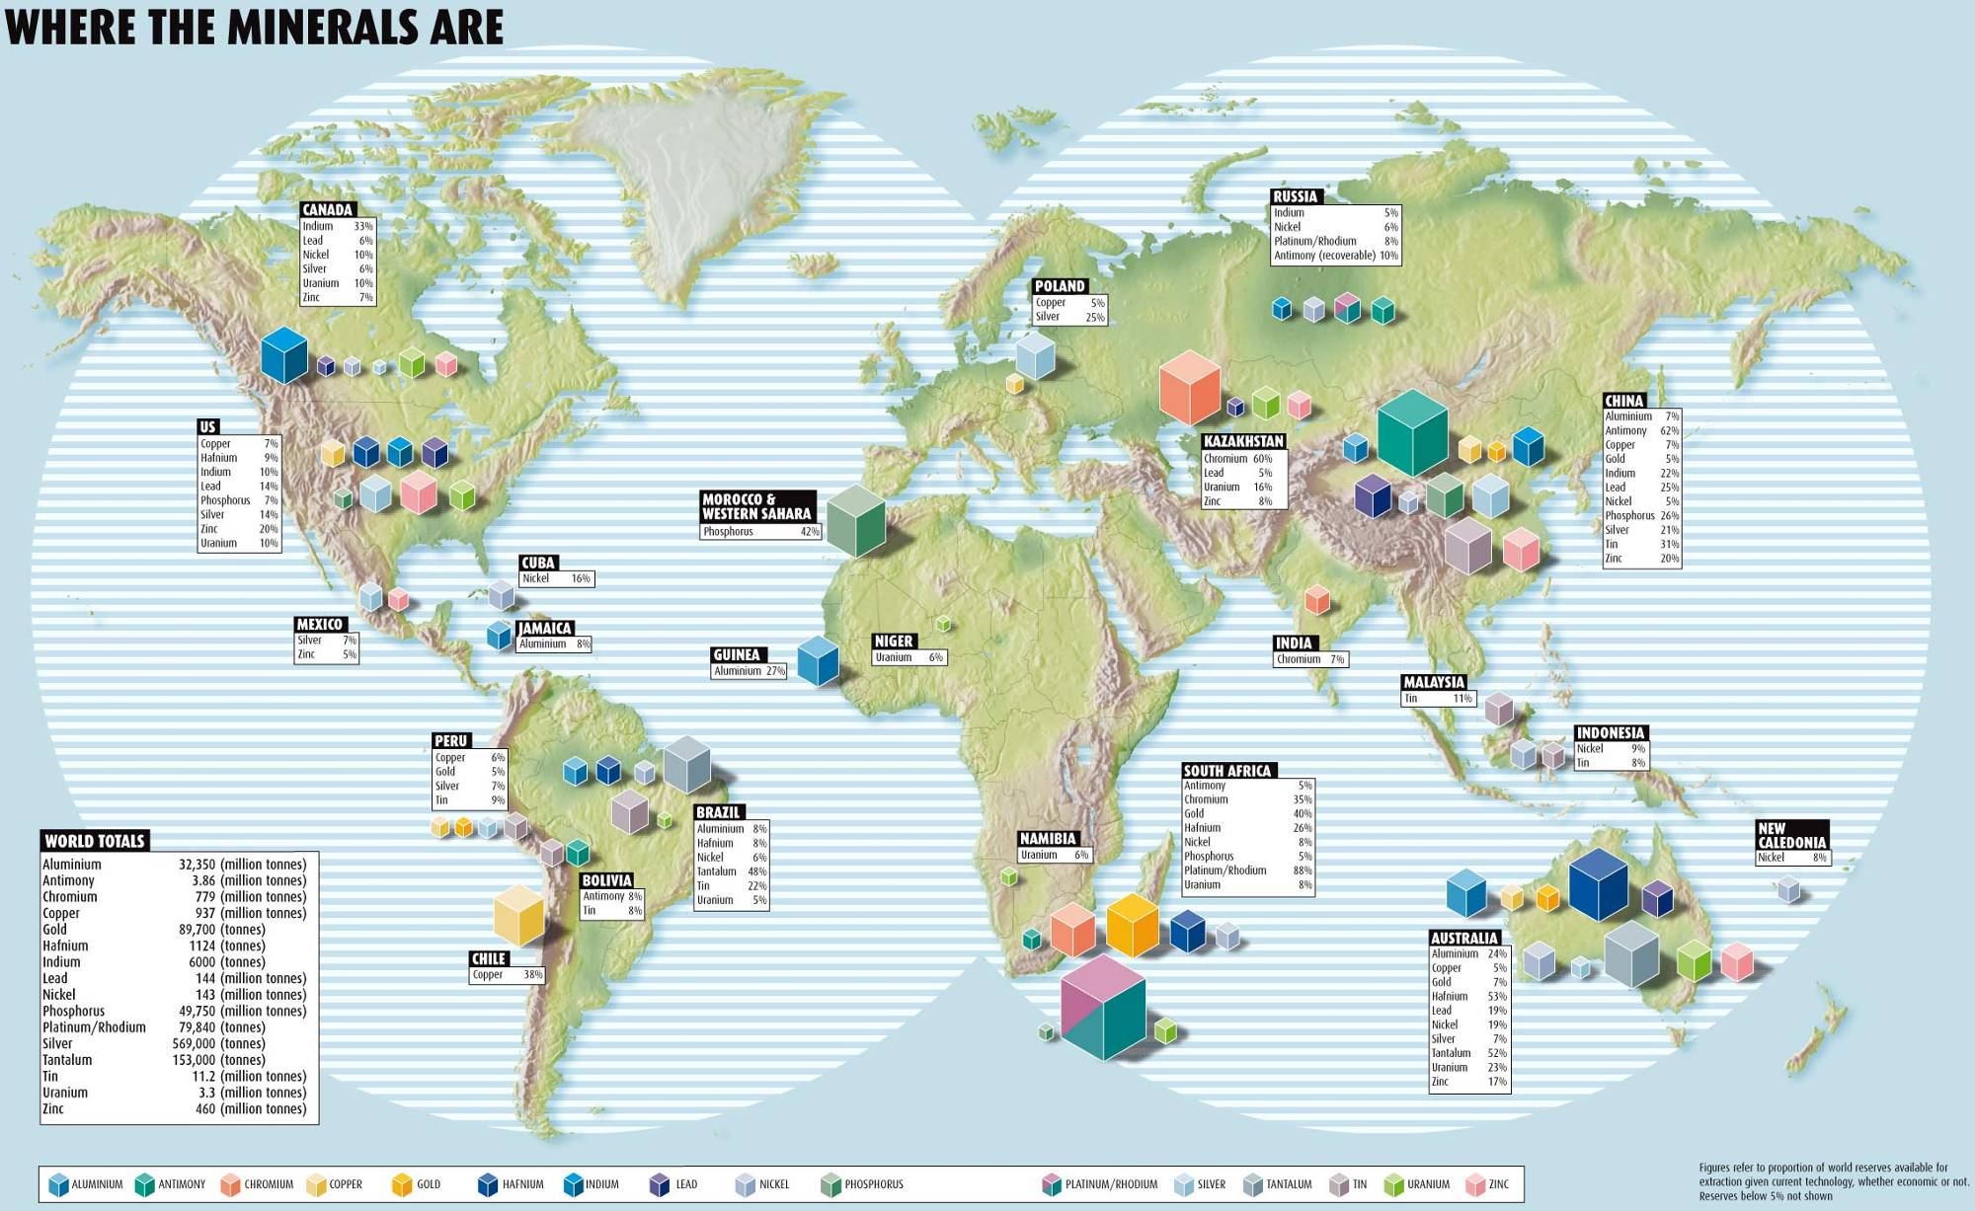
Where the minerals are..

Slide 8
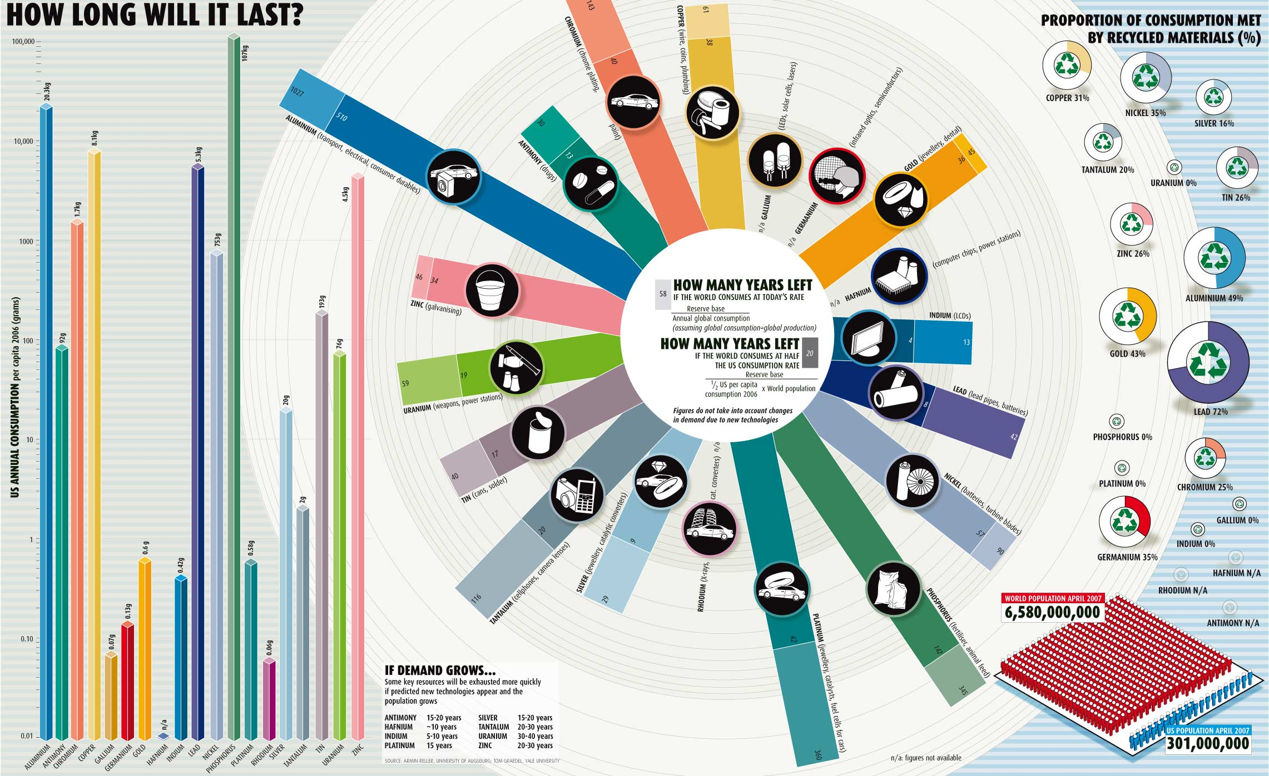
Sustainable use of Materials: why?
Societal Challenges

Slide 9
Sustainable use of Materials: why?
Societal Challenges

Slide 10
Hoeveel raw materials hebben we nog?
Availability | Diederen | Kesler | Cohen (zie figuur 1) |  | Frondel et al.
 | 2009 | 2007 | 2007 |  | 2007
Scenario | 2% groei scenario | Gebaseerd op 1992 consumptie | Huidige consumptie | Gemiddelde consumptie is ½ US consumptie | Huidige consumptie
 | [years] | [years] | [years] | [years] | [years]
Metal
Cu | 25 | 25-50 | 61 | 38 | 32
Fe | 48 | >100 |  |  | 119
Ag | 12 | 10 à 25 | 29 | 9 | 14
Au | 15 | 10 à 25 | 36 | 45 | 17
Pd/Pt/Rh |  |  | 360 | 42
Sn | 17 | 25-50 | 40 | 17 | 23
Ni | 30 | 50-100 | 90 | 57 | 44
Al | 65 | >100 | 1027 | 510 | 157
Pb | 19 | 10 à 25 | 42 | 8 | 21
Zn | 15 | 10 à 25 | 46 | 34 | 23
Ga | ?
Co | 59 | 50-100 |  |  | 135
Bi | 38 | 25-50 |  |  | 65
In | 18 | 10 à 25 | 13 | 4 | 7
Cd | 20 | 25-50 |  |  | 32
Sb | 14 | 50-100 | 30 | 13 | 16
Ti | 61 |  |  |  | 130

Slide 11
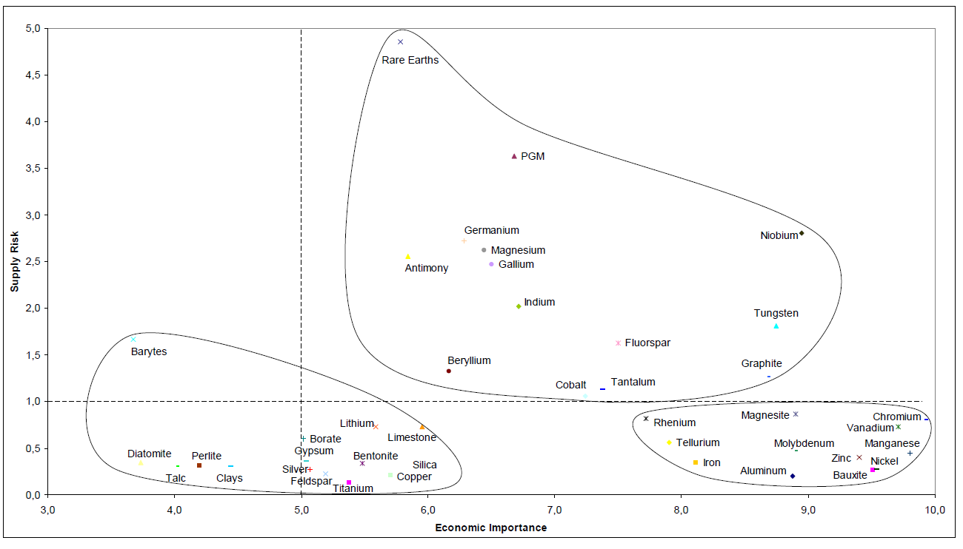
14 Critical metals for Europe
Supply risk
Economic Importance
EC; DG ENT, 2010, http://ec.europa.eu/enterprise/policies/rawmaterials/documents/index_en.htm

Slide 12
Critical metals
Economic importance (green closed loop economy)
High Supply risk
Limited and/or localised reserves
Concentration of production
Low substitution
Limited recycling level

Slide 13
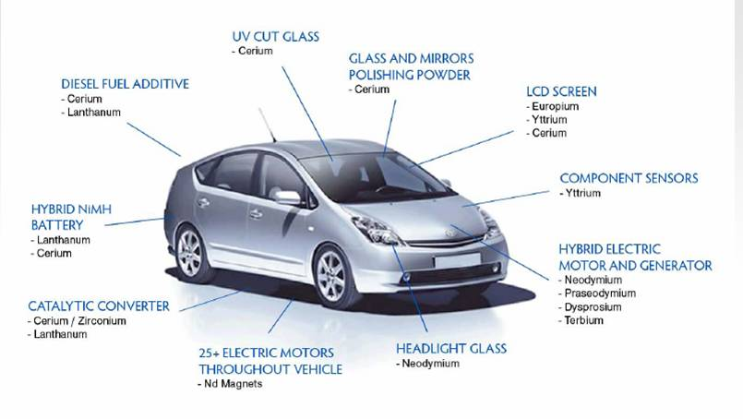
14 Critical metals for Europe
Societal Challenges

Slide 14
Critical raw materials at EU-level | Technologies | Link met andere cruciale uitdagingen
Antimony | ATO, micro capacitors
Cobalt | Lithium-ion batteries, synthetic fuels | Energie opslag / duurzaam transport (elec. Voertuigen)
Gallium | Thin layer photovoltaics, IC, WLED | Duurzame energievoorziening
Germanium | Fibre optic cable, IR optical technologies
Indium | Displays, thin layer photovoltaics
Platinum (PGM) | Fuel cells, catalysts | Energie opslag /duurzaam transport
Palladium (PGM) | Catalysts, seawater desalination | Zoet water aanbod
Niobium | Micro capacitors, ferroalloys
Neodymium (rare earth) | Permanent magnets, laser technology | Duurzame energie voorziening
Tantalum | Micro capacitors, medical technology

Slide 15
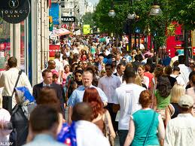
Sustainable use of Materials: why?
Societal Challenges
World:
+ 3 billion middle class consumers next 20 years
EU :
16 tonnes material/ citizen.year
20% imported
40% recycled
Limited resources vs. High needs
But: large opportunities

Slide 16
Your vision on sustainable use of materials

Slide 17
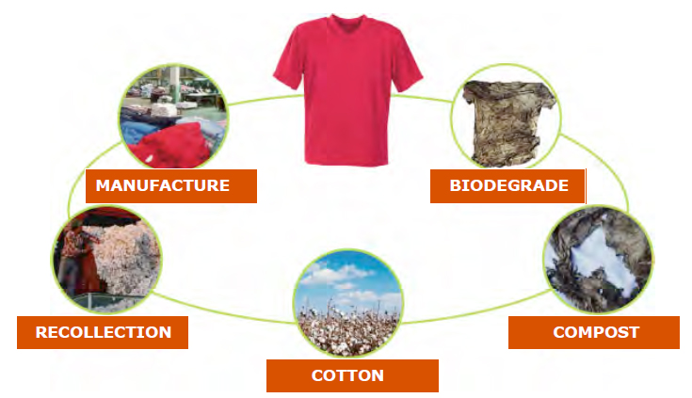
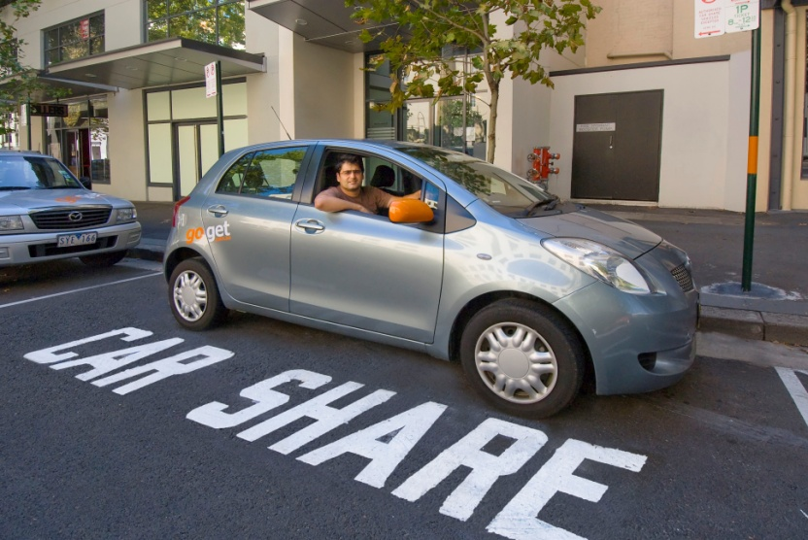
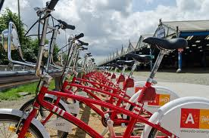
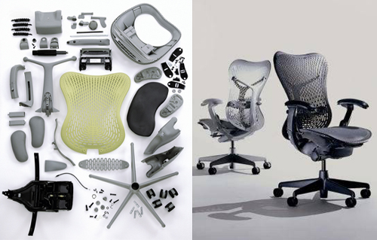

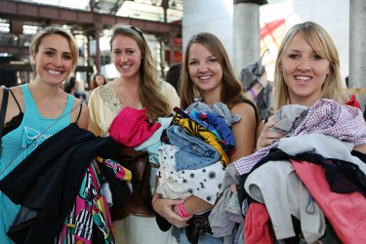
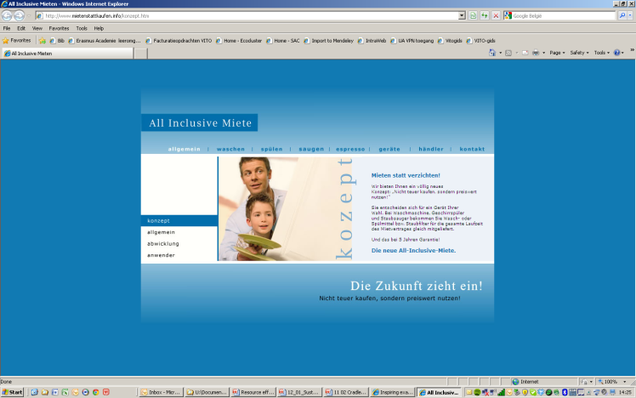
A vision on sustainable use of materials

Slide 18

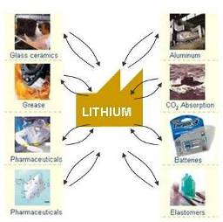
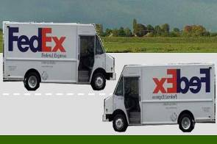
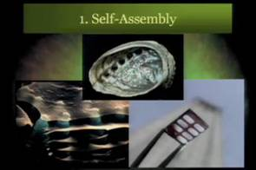
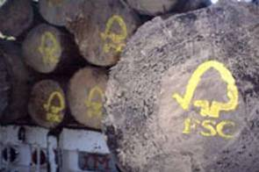
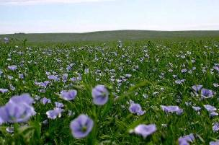
Vlaanderen in actie?
Closed material cycles
technosfeer
Closed material loop
biosfeer
Extended producer responsibility
biomimetic materials
Waste as a fuel
Reversed logistics
A
B
biobased materials
Labelling and control of material flows
2008
Non-transparent, global materials flows
2030

Slide 19




achtergrond
Phase 3
Innovation driven economy
Phase 2
Efficiëncy driven economy
Phase 1
Factor driven economy
Continuous loops
Diversity
Pro-active
Re-manufacturing
Use
Product responsibility
Prevent
Eco-efficiency
Re-active
Waste
Own
Supply Chain
IMPACTS
Source: Flanders District of Creativity “The Creative Economy: Challenges and opportunities for the DC Regions”, april 2006

Slide 20
achtergrond
Source: Flanders District of Creativity “The Creative Economy: Challenges and opportunities for the DC Regions”, april 2006

Slide 21
A vision on Sustainable use of Materials
Sufficiency
Resilient material cycles
Industrial Symbiosis
CO₂-looping
Cluster thinking
Closed lean cycles
One-on-one production
Biocycle vs. Technocycle
Digital ecodesign
Service-based economy
Sharing is the new owning
Sustainable choices made easy
Local production
Local exchange of equipment

Slide 22
basic principles
Urban Mining - Minimise primary need
Resource effective production
Closed lean material loops
Life cycle thinking: assessment and strategies

Slide 23
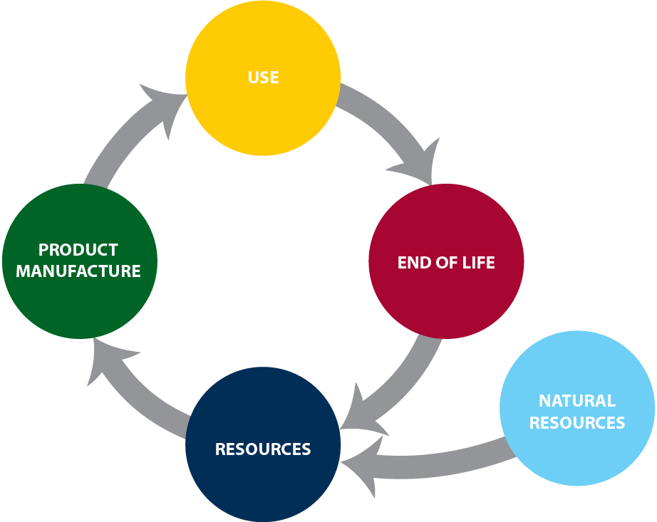
Sustainable use of Materials: what?
Societal Challenges

Slide 24
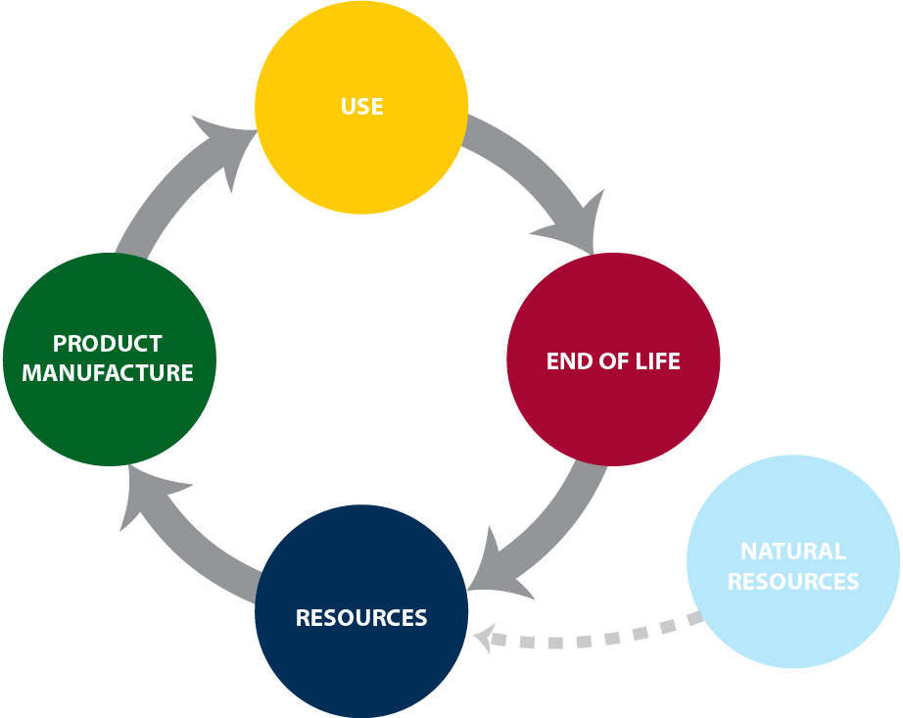
Sustainable use of Materials: what?
Urban Mining
Limit use of natural resources
Recycle material stocks

Slide 25
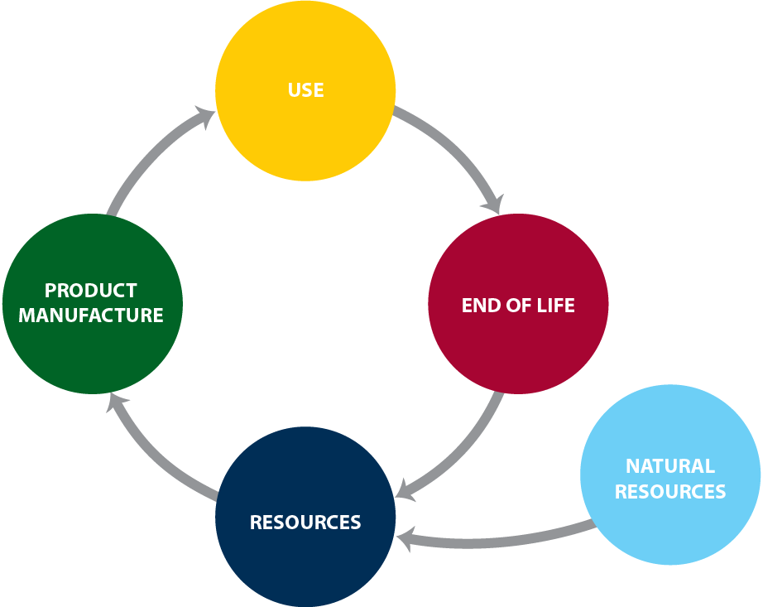
Sustainable use of Materials: what?
Resource Effective Production
Minimise material use
Substitute scarce materials
Functionalise materials

Slide 26
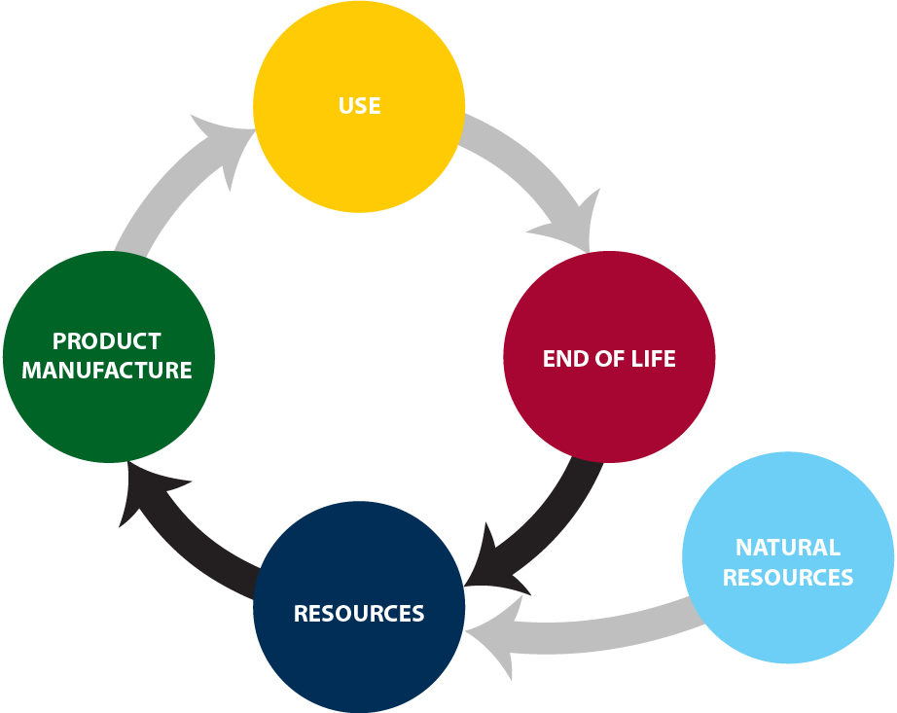
Sustainable use of Materials: what?
Closed Lean Material Loops
Upcycle end-of-life products
Set up flexible material cycles
Waste-to-product

Slide 27
Sustainable use of Materials: what?
Material Life Cycle Thinking
Evaluate life cycle
New business models

Slide 28
Sustainable use of Materials: basic principles
Research Programme
Closed lean
material
loops
Material life cycle thinking
Resource Effective Production
Urban Mining

Slide 29
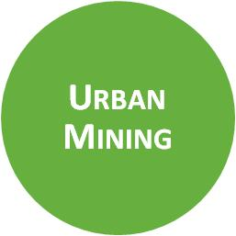


Materials Technology | Secondary raw materials | Transition management | Environment, health & safety
Material Life Cycle Thinking

Slide 30

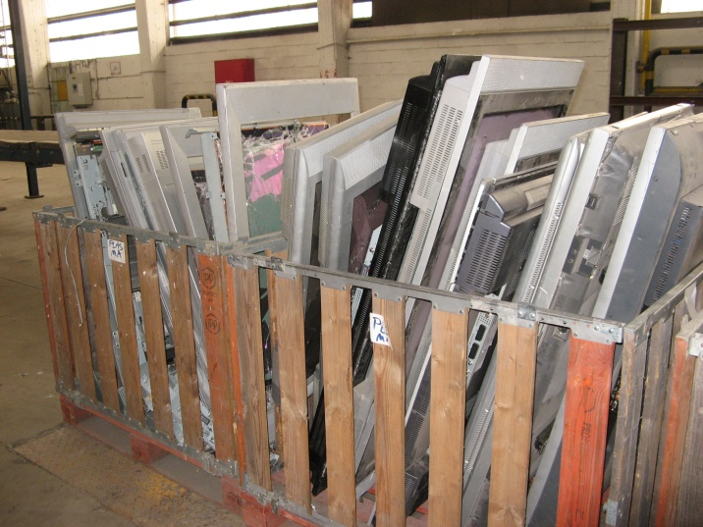
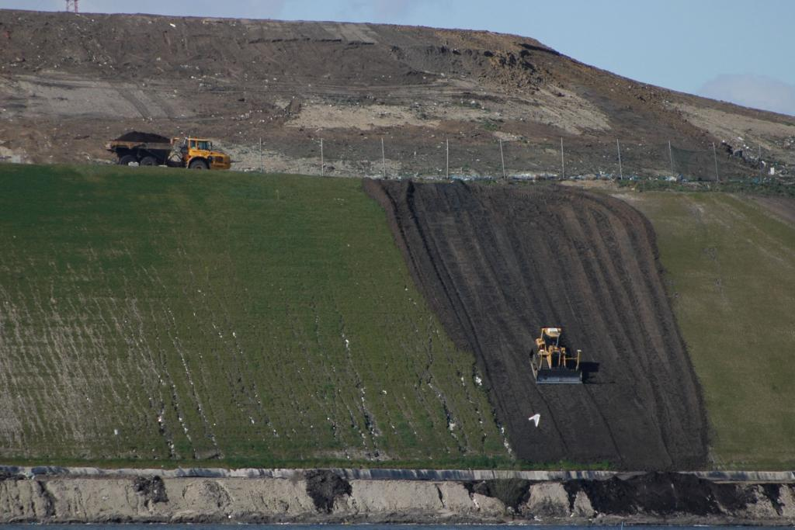
Urban Mining
Separation technologies
Hazard assessment
Evaluation of options and strategies
Inventory of potential
BEBAT: recycling options for consumer batteries
Philips, Umicore: recycling and design for dismantling of LED TVs
Machiels: enhanced landfill mining

Slide 31
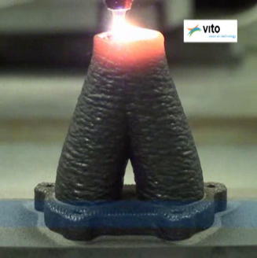
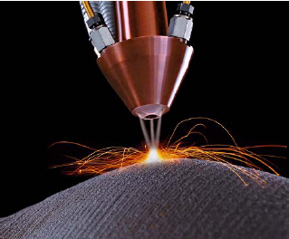

Resource Effective Production
Advanced materials engineering
Surface technology
Health and safety assessment
Sustainable business models
Shift to abundant materials
Haskoning, J&J: Take Back Chemicals
Wienerberger: sustainable bricks

Slide 32
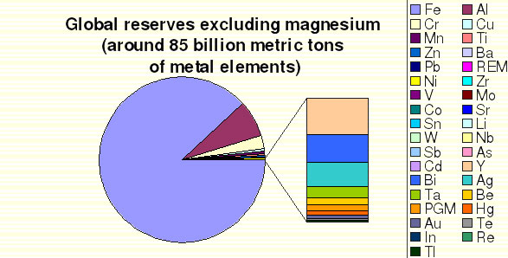
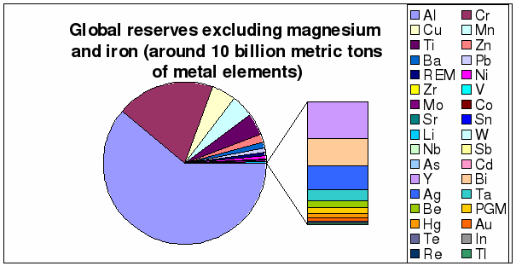
Resource Effective Production

Slide 33
Substitution constraints
Resource Effective Production
Metals with high relative reserves, but low total amount and low extraction rate (e.g. Li as substitute for Ni)
Metals with no substitute and low reserve (e.g. Mn)
High relative reserve and large absolute amounts, in few geographic locations (e.g. Cr: Kazachstan and S-Africa)
Increased extraction efficiency?
But: Jevon’s Paradox:
increase in resource efficiency of a material,
increases its rate of consumption

Slide 34
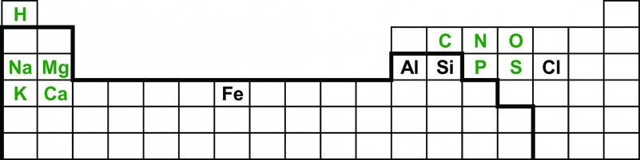
Elements of hope
Resource Effective Production
Mined from earth’s crust, oceans and atmosphere
Incl. Plastics from biomass, macronutrients
Diederen, 2009, http://www.vraagenaanbod.nl/download/Metal_minerals_scarcity.pdf

Slide 35
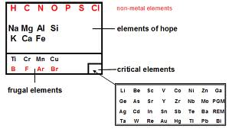
Elements of hope
Resource Effective Production
Diederen, 2009, http://www.vraagenaanbod.nl/download/Metal_minerals_scarcity.pdf

Slide 36

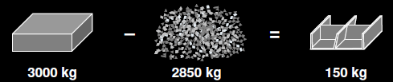
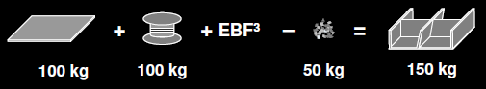
Material effective production
Additive manufacturing AM
Resource Effective Production
http://www.youtube.com/watch?v=vAi3fUlMdHk
AM

Slide 37
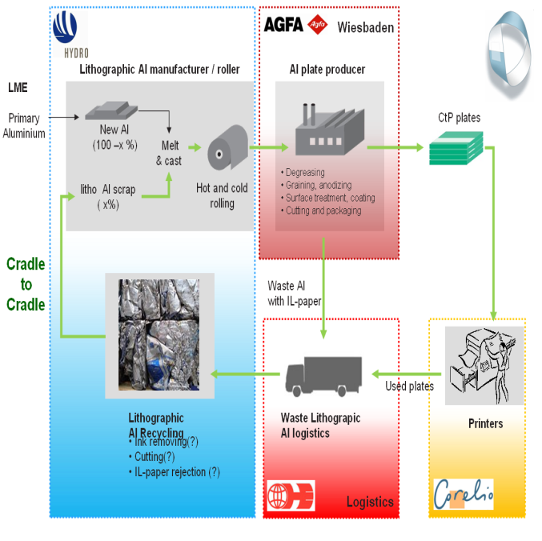
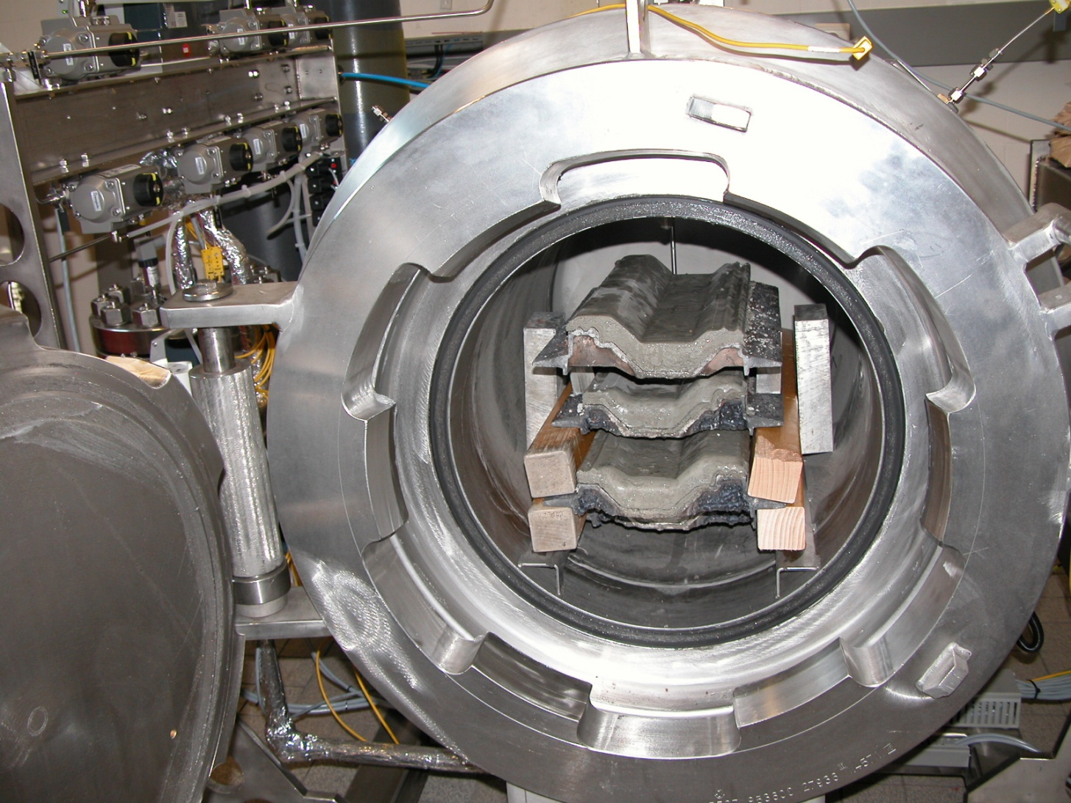
Closed Lean Material Loops
Conversion technologies
Industrial Symbiosis
Policies for end of waste
Technologies for waste to product
Toxicology of recycled materials
Agfa, Corelio : closing the Al loop in printing
OVAM: Ecoclusters industrial symbiosis
EC DG ENV: strategy for sustainable resources management

Slide 38


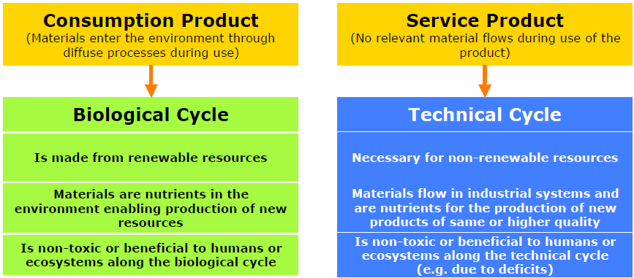
C2C
principes
achtergrond
C2C
concept
C2C
waste = food
use current solar income
celebrate diversity
bron: EPEA
bron: EPEA

Slide 39
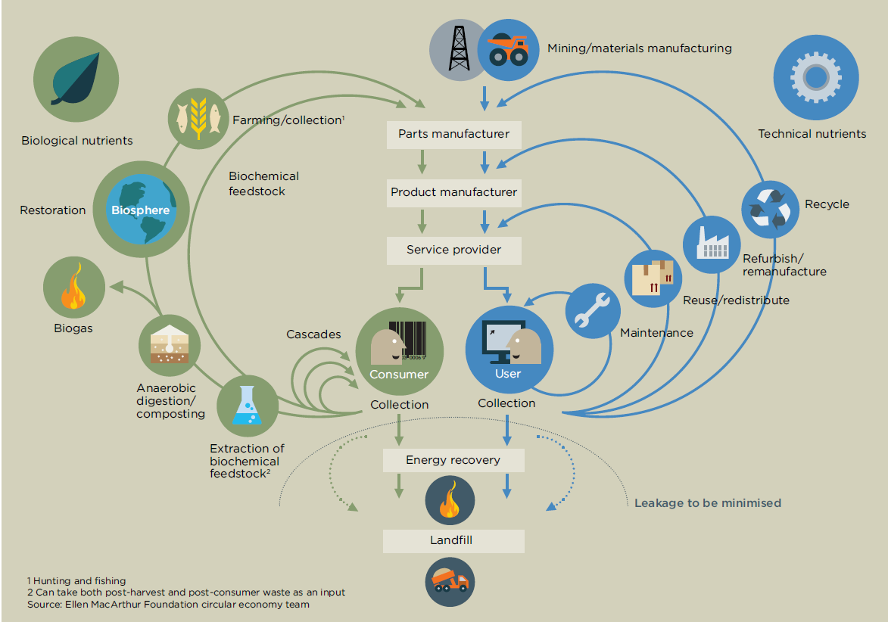
Ellen MacArthur Foundation, 2011, Towards the circular economy

Slide 40

Conclusies
C2C biedt nieuwe inzichten
Eco-effectiviteit
100% kringlopen
Positief verhaal
Daagt uit om anders te denken
Maar… breder transitieverhaal mbt Sustainable resources management:
Hoe kringlopen organiseren
Energie – efficiëntie aanpak noodzakelijk
Energie ~ materialen
Mobiliteit
Nieuwe businessmodellen?
…
bouw
Closed Lean Material Loops

Slide 41
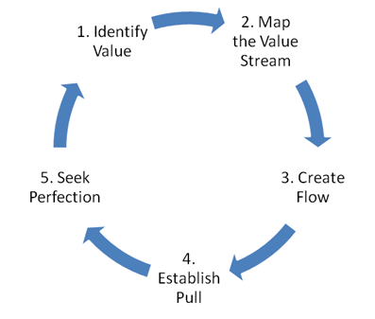
Starting point: Lean Thinking
Closed Lean Material Loops
Specify value from the standpoint of the end customer.
Identify all the steps in the value stream, eliminating
whenever possible those steps that do not create value.
Make the value-creating steps occur in tight sequence so the product will flow smoothly toward the customer.
As flow is introduced, let customers pull value from the next upstream activity.
As value is specified, value streams are identified, wasted steps are removed, and flow and pull are introduced, begin the process again and continue it until a state of perfection is reached in which perfect value is created with no waste.

Slide 42
From lean thinking to closed lean cycles
Closed Lean Material Loops
Lean thinking princples can be applied to a material cycle context
This has the advantage that we use the vocabulary of the industry to introduce a new sustainability concept
We see this as a means to stimulate action in industry in the field of closing material loops
This generates the concept of ‘closed lean cycles’.

Slide 43
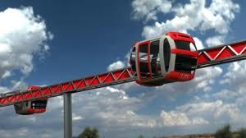
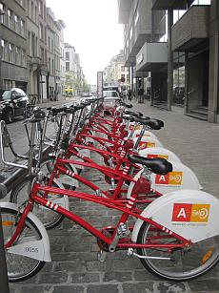
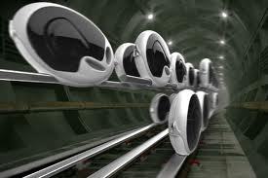
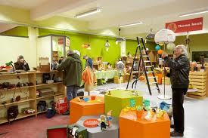
Life Cycle Thinking
Life cycle assessment,
LC- costing, social-LCA
Ecodesign strategy
Sustainability assessment
Consumer behaviour
Sharing systems
Transition projects
SMEs, sectors: LCA-studies
Limburg, Ghent: transition to climate neutral region
Kringwinkels: vision 2030

Slide 44


Duurzame samenleving
Transitie-denken
Groene
economie
Duurzaam materiaalbeheer
Eco-efficiëntie
Eco-effectiviteit
Transitie is een gradueel continu proces van maatschappelijke verandering, waarbij de maatschappij (of een complex deelsysteem ervan) structureel van karakter verandert
Notes:
LiDS: life cycle design strategies

Slide 45

Transitie: multilevel perspectief
Persistente problemen
Leitbild
Oplossingsrichtingen
Regime-analyse
Niche-innovatie

Slide 46
SuM in transition context
Consumption and Production
Product
Resources Management
Landscape
Regime
Niche
prod
use
distrib
eol
material

Slide 47
Materials Technology | Secondary raw materials | Transition management | Environment, health & safety
Material Life Cycle Thinking

